Slide 1

Meta-analysis on the Association Between Air Pollution and Increased Risk of Health And Pulmonary Diseases.
Department of Computer Science & Engineering
Team Members :-
1. SHADAN SARFARAZ 33200120047
2. SAYAN HALDER 33200120051
3. SHADMAN SARFARAZ 33200120062
4. SAYAK BHATTACHARYYA 33200120058
5. ABHIJIT DEY 33200121158
Guide Name: Prof. TANUSHREE CHAKRABORTY
Designation: Assist. Prof, CSE Department, Techno International Batanagar

Slide 2
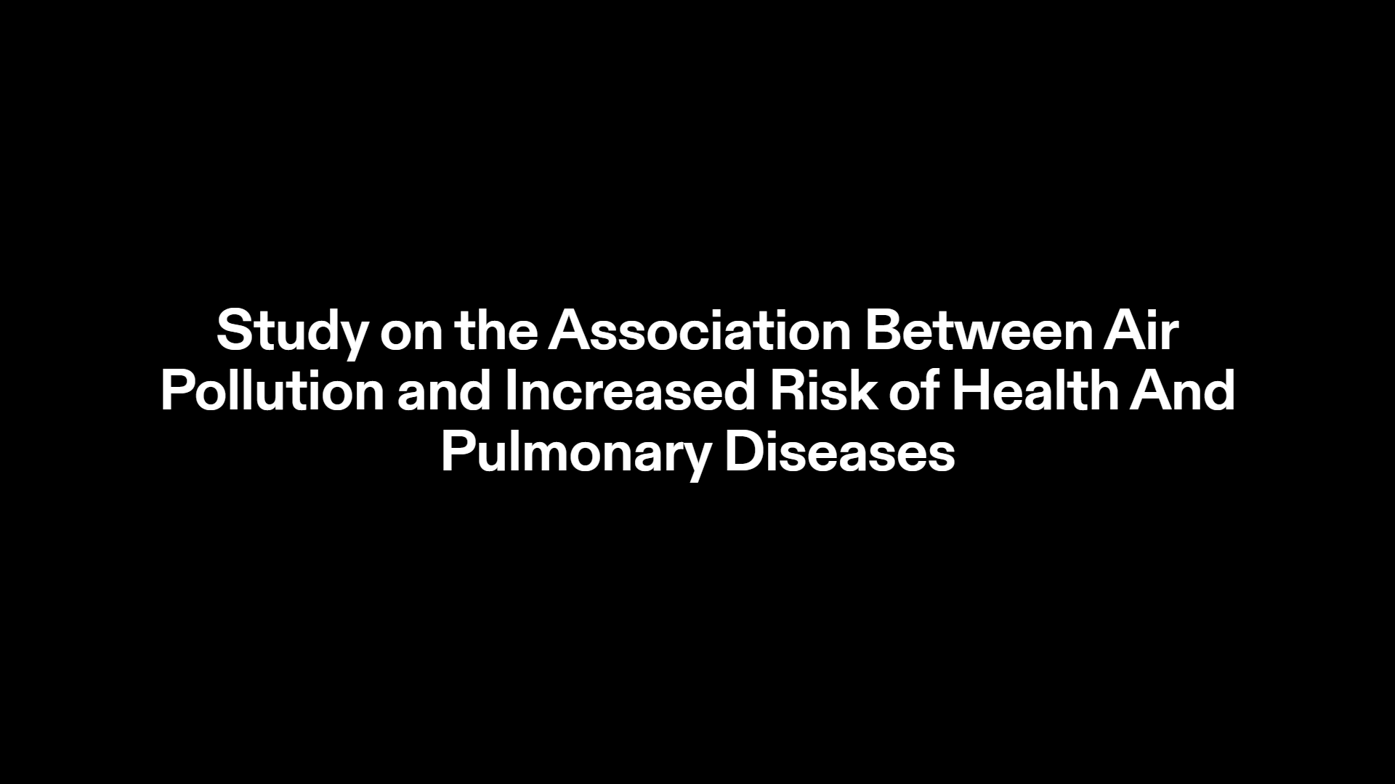
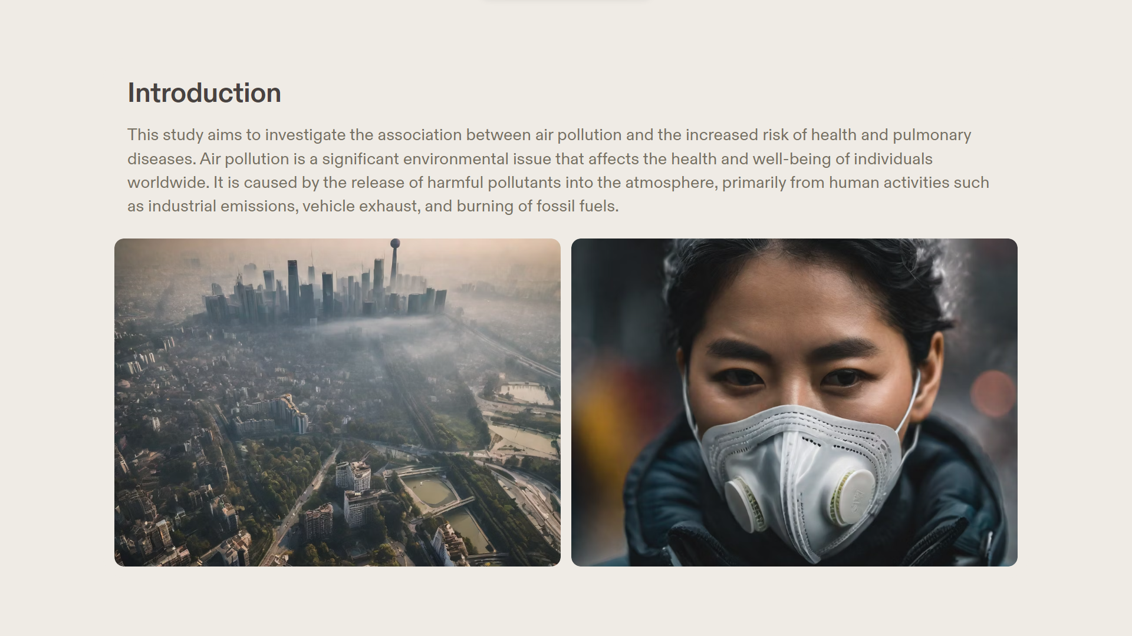
This analysis aims to understand the association between air pollution and the increased risk of health and pulmonary diseases. Air pollution is a significant environmental issue that affects the health and well-being of individuals worldwide. It is caused by the release of harmful pollutants into the atmosphere, primarily from human activities such as industrial emissions, vehicle exhaust, and burning of fossil fuels.

Slide 3
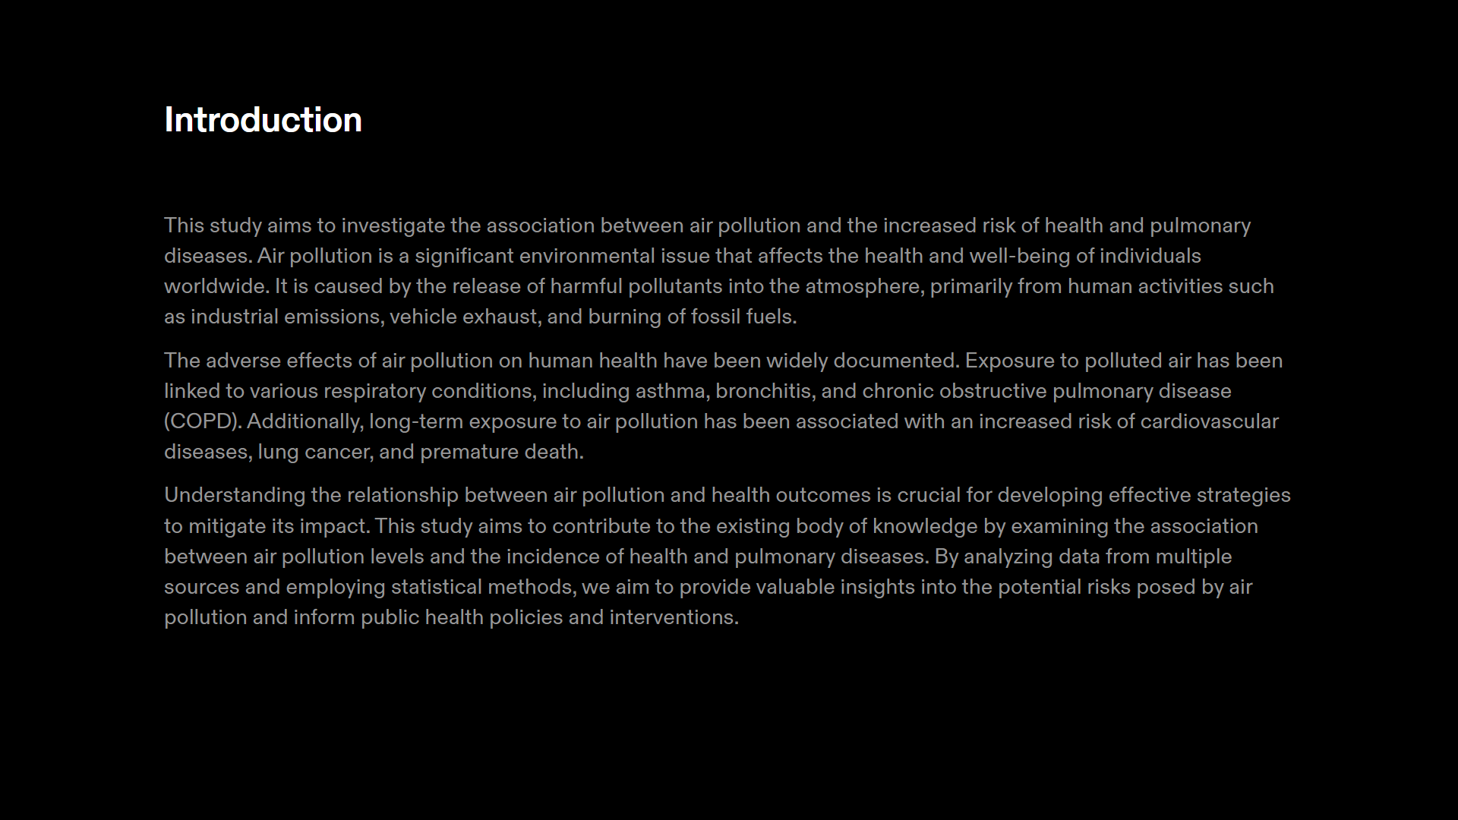
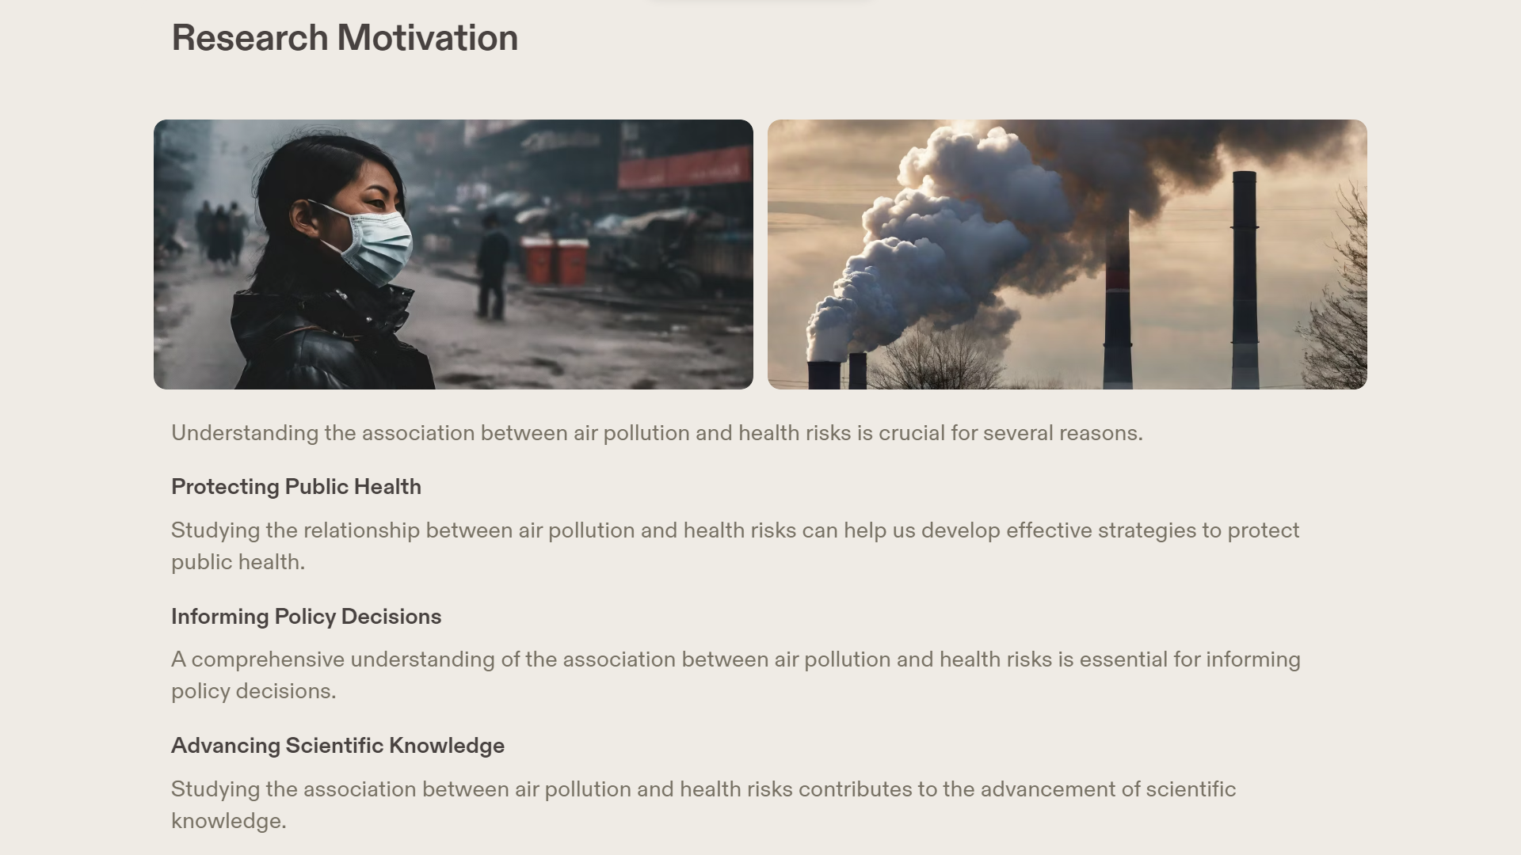

Slide 4
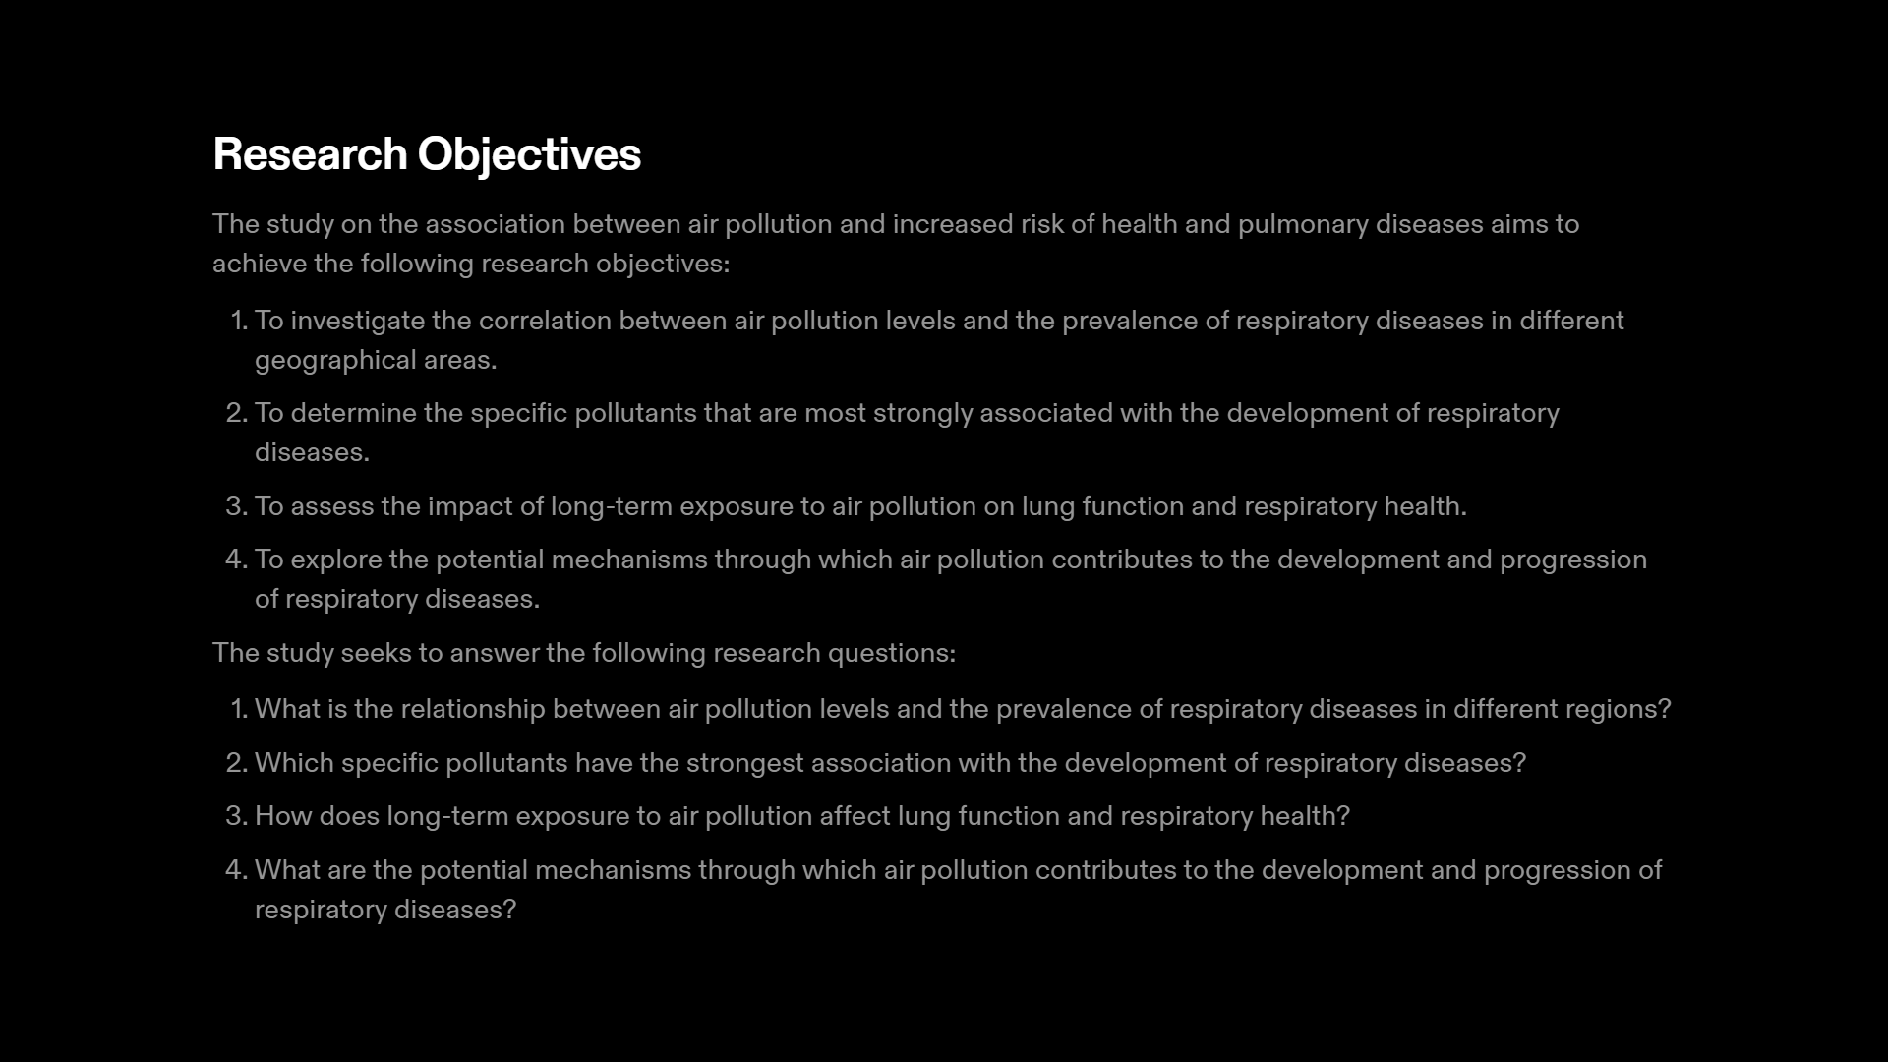
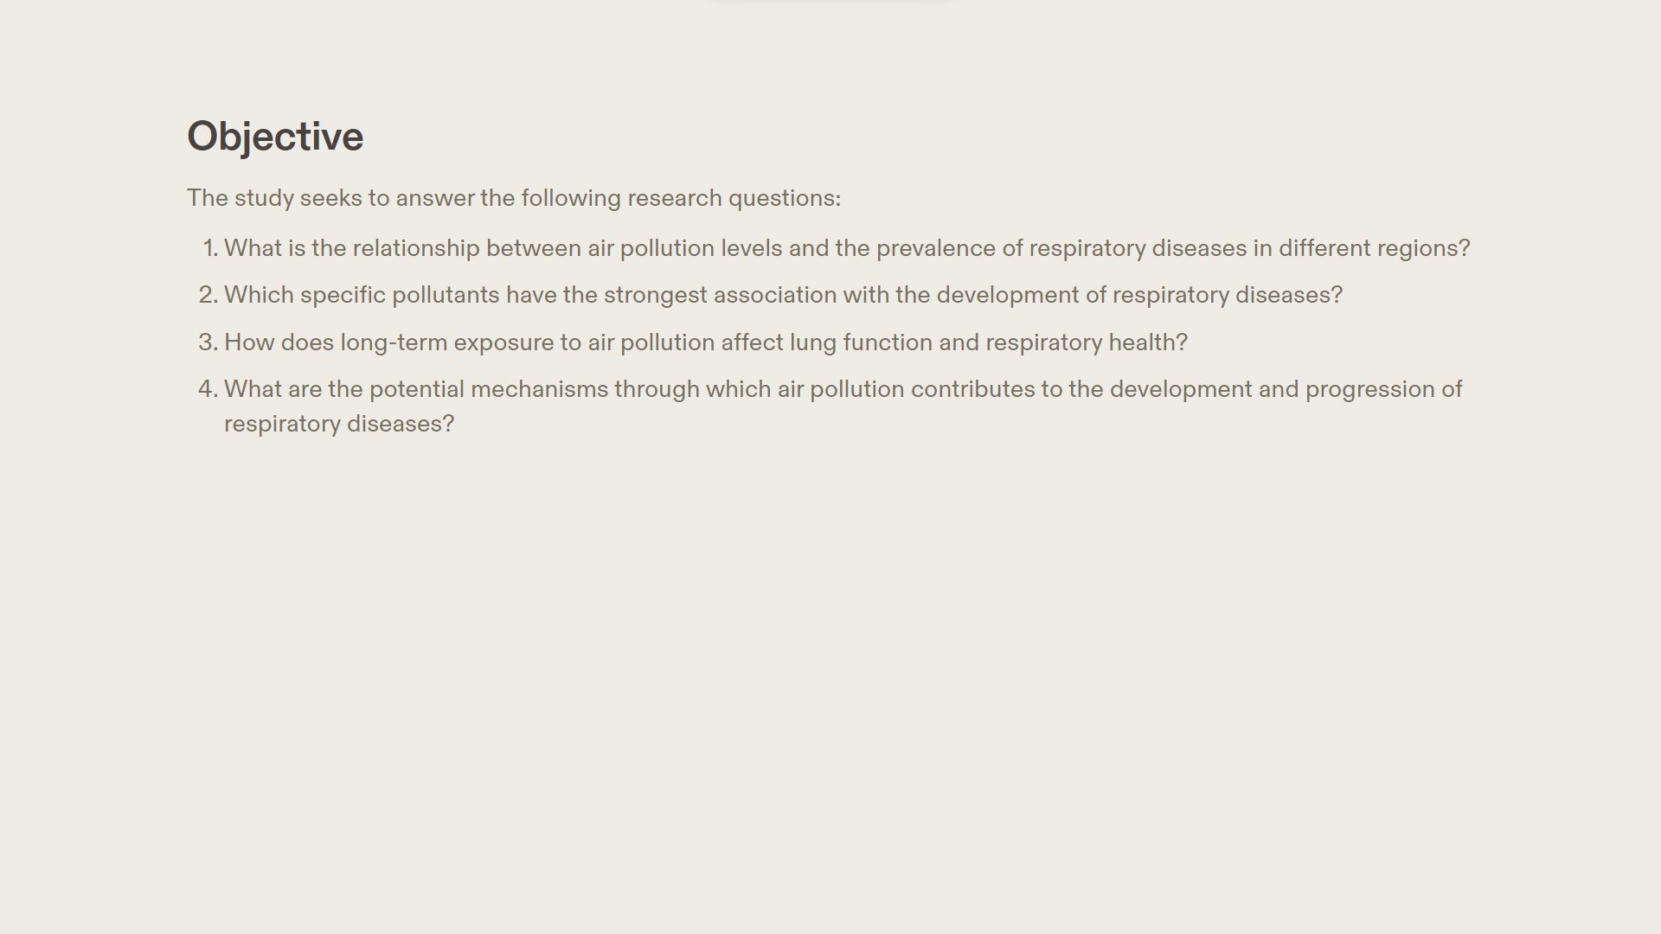

Slide 5
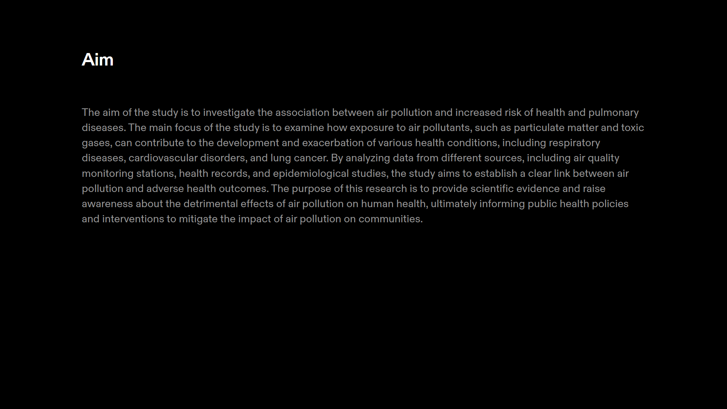
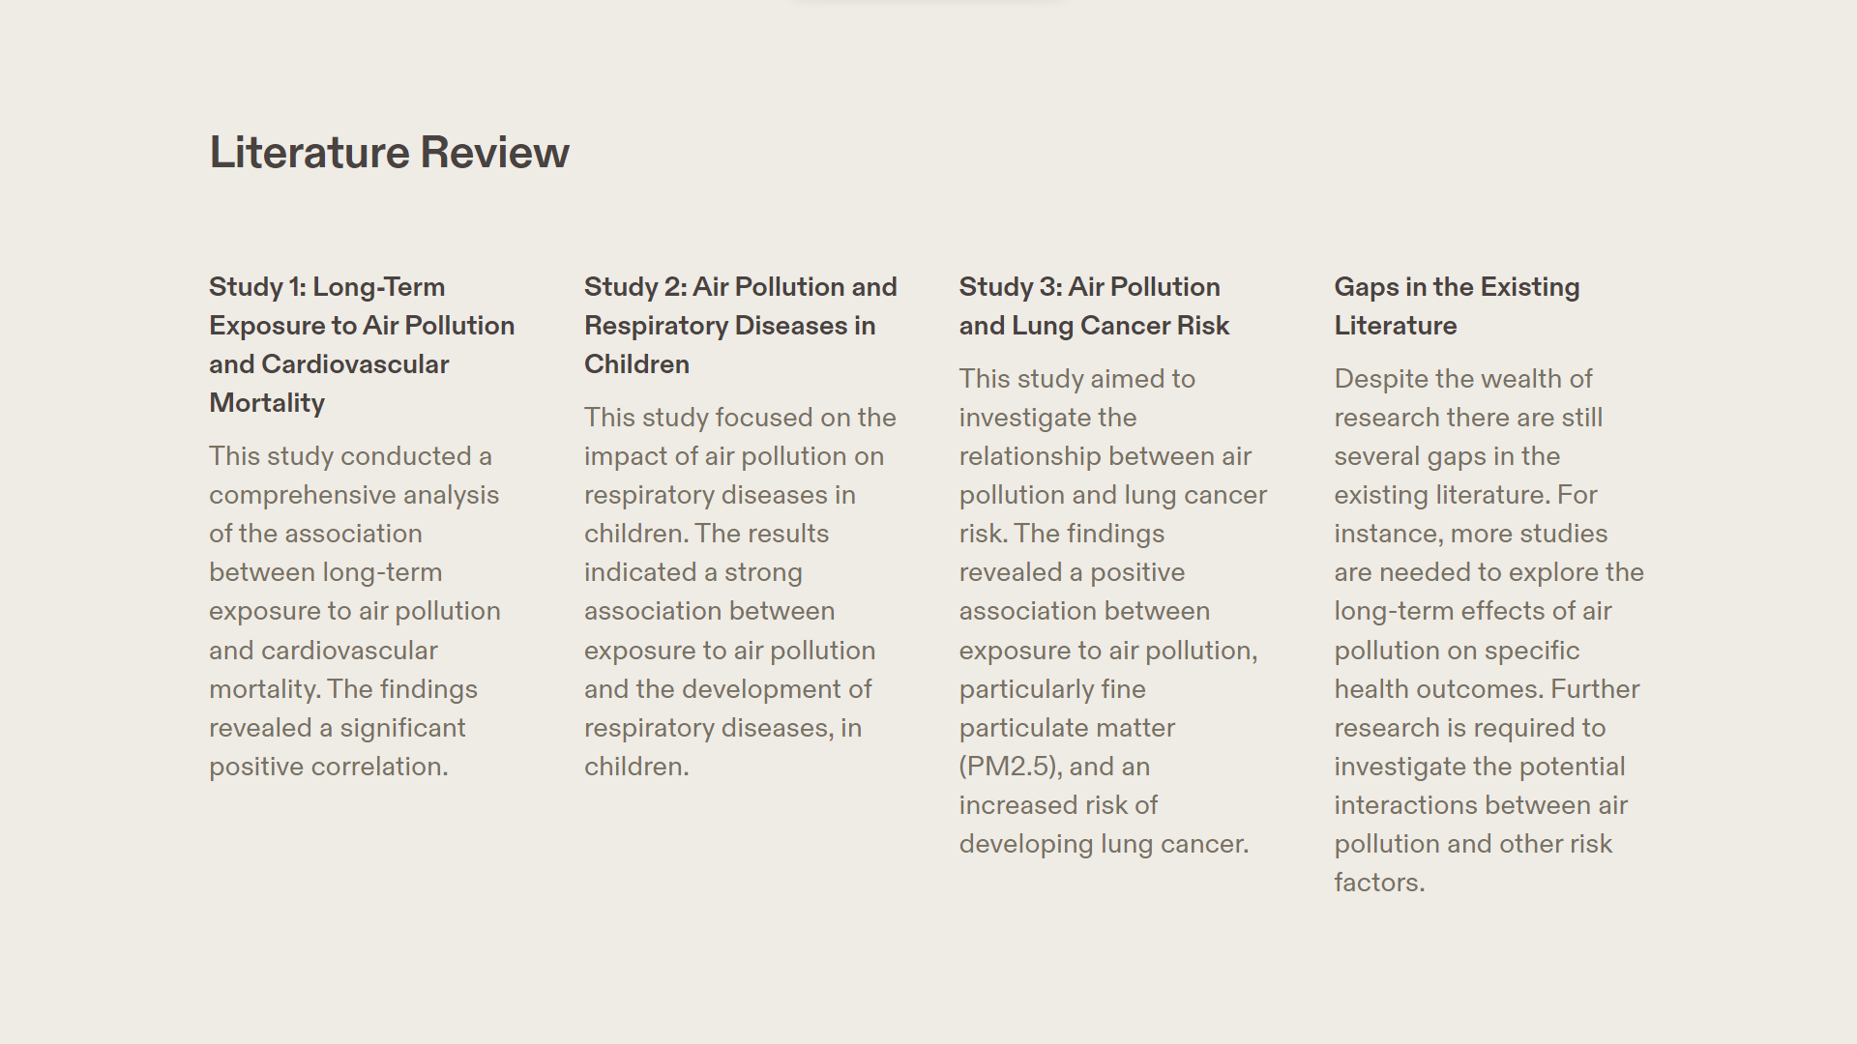

Slide 6
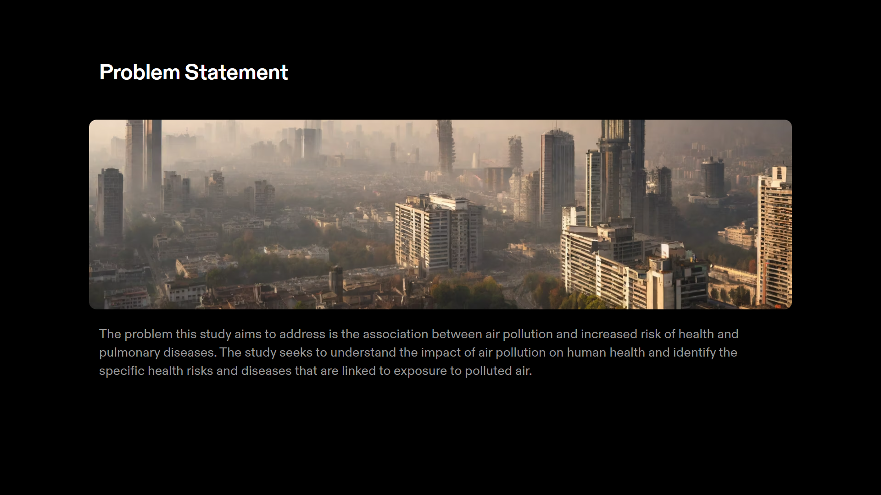

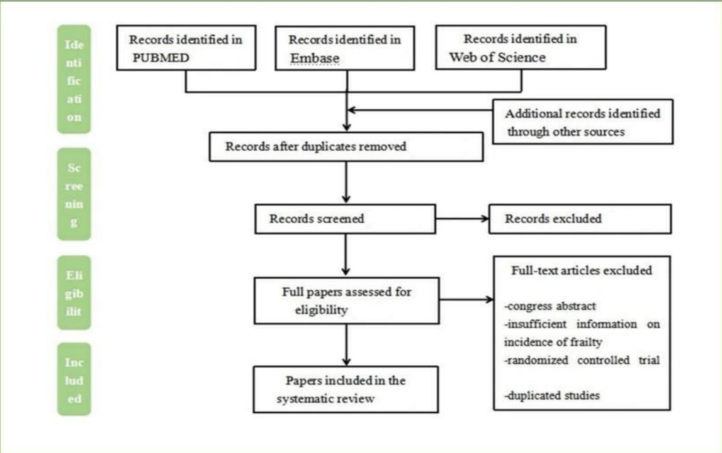

Slide 7
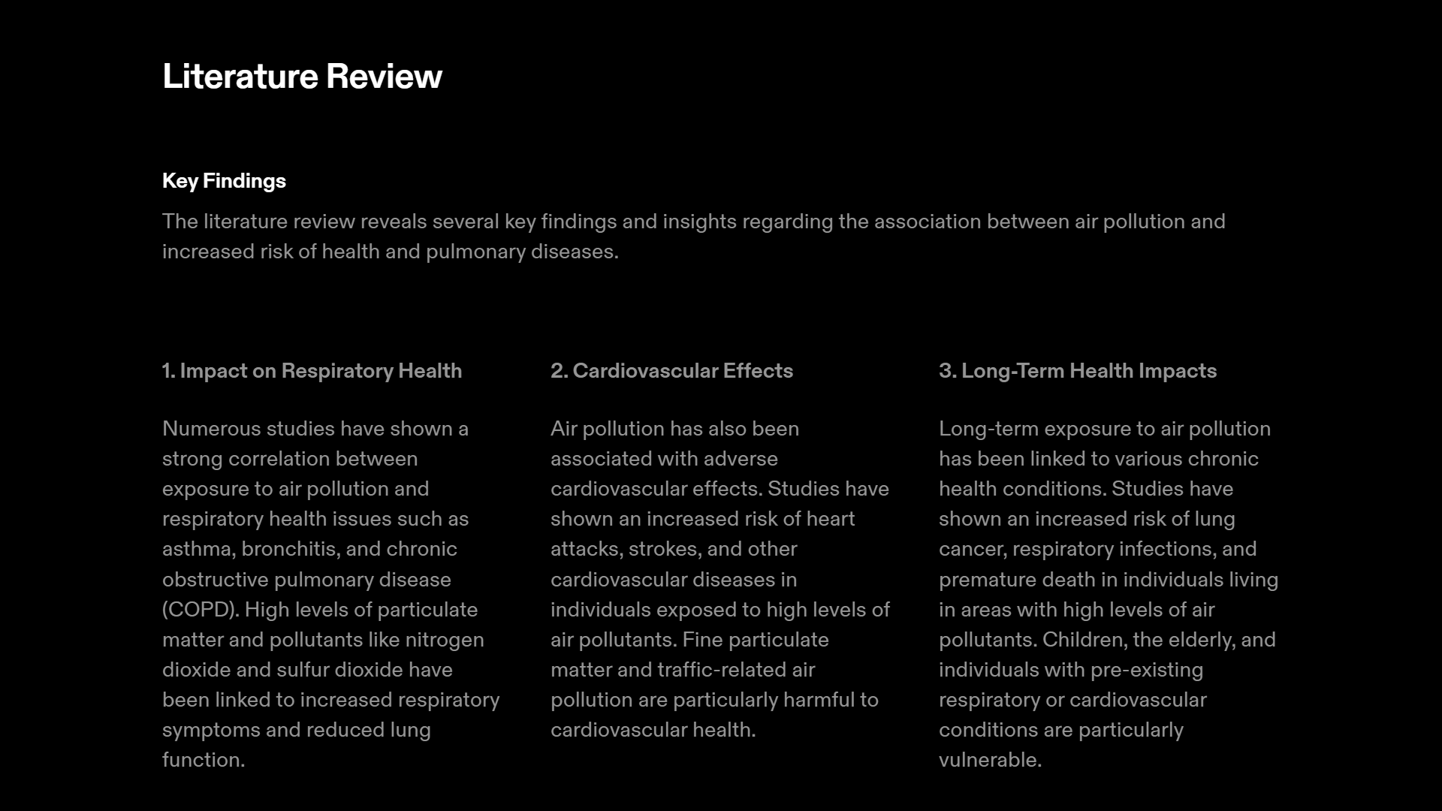
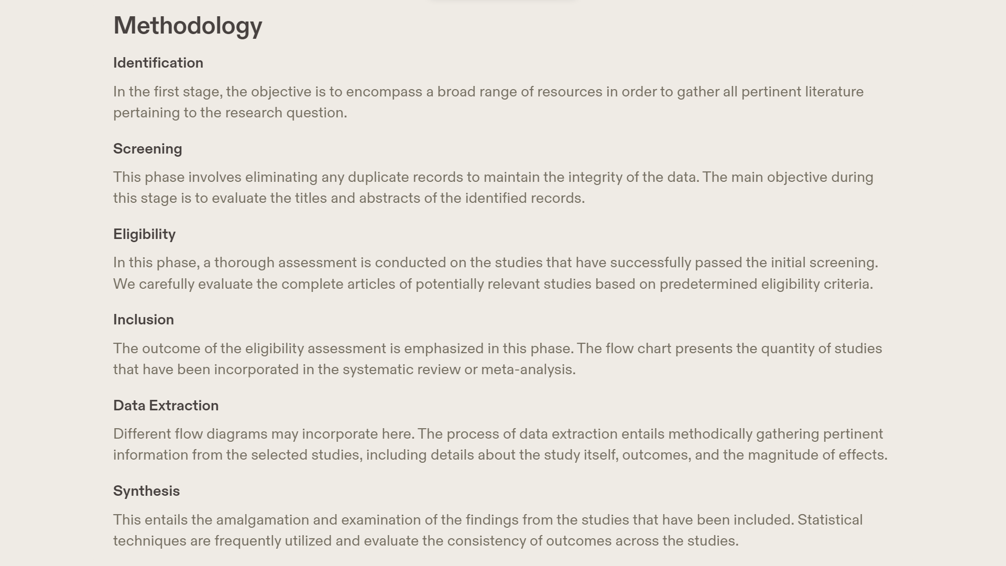

Slide 8
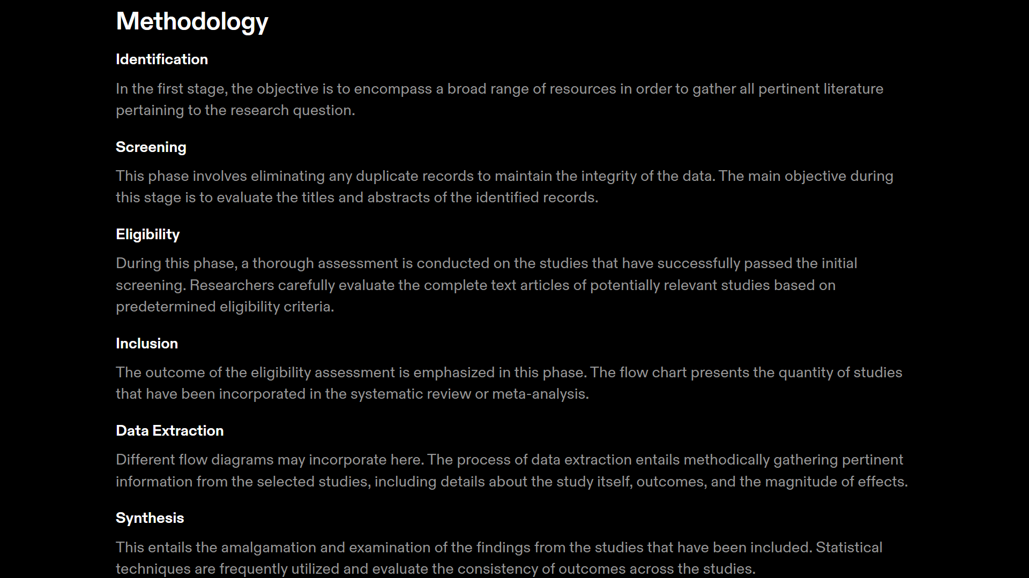
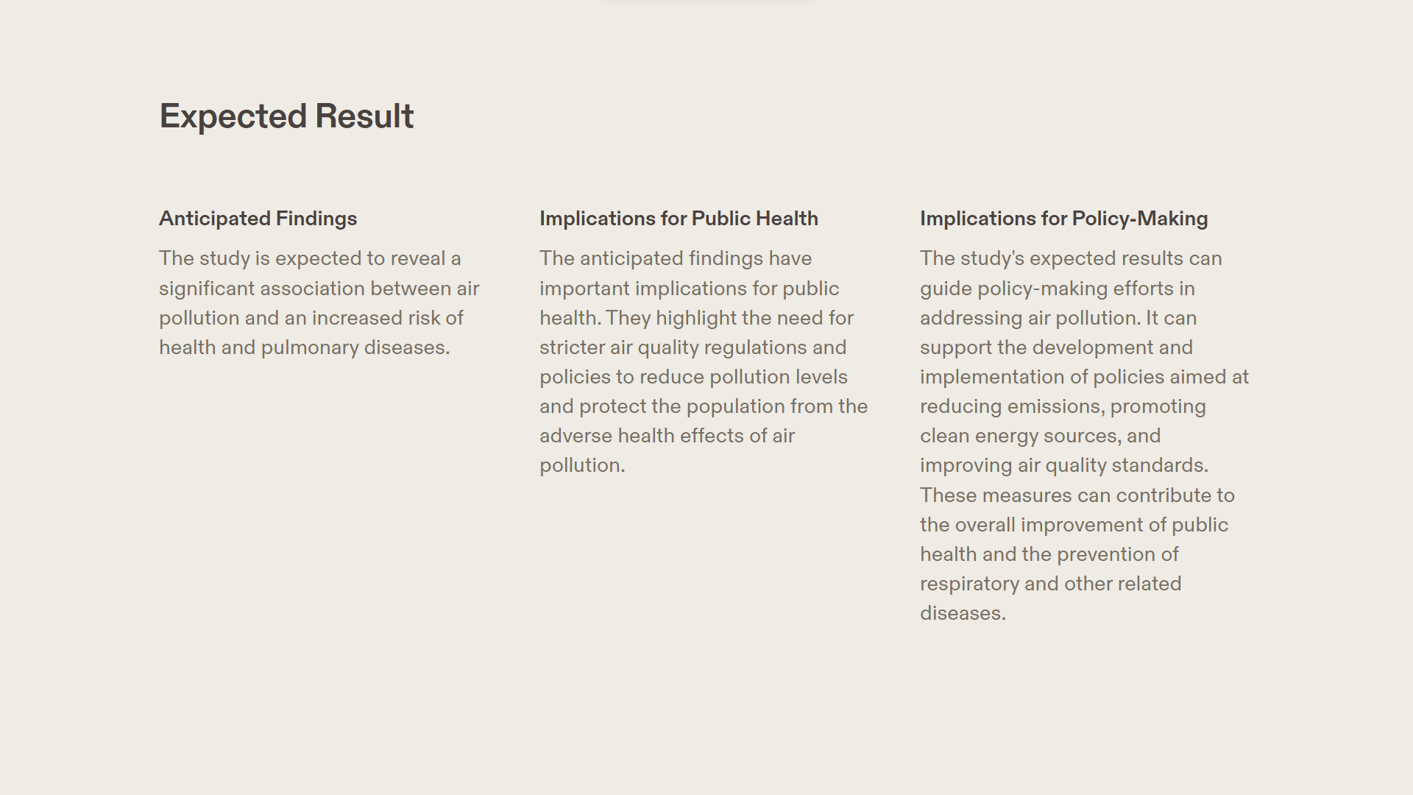




This meta-analysis revealed a significant association between air pollution and an increased risk of health and pulmonary diseases among peoples with different ages.
The findings have important implications for public health. They highlight the need for stricter air quality regulations and policies to reduce pollution levels and protect the population from the adverse health effects of air pollution.
This analysis's results can guide policy-making efforts in addressing air pollution. It can support the development and implementation of policies aimed at reducing emissions, promoting clean energy sources, and improving air quality standards. These measures can contribute to the overall improvement of public health and the prevention of respiratory and other related diseases.

Slide 9
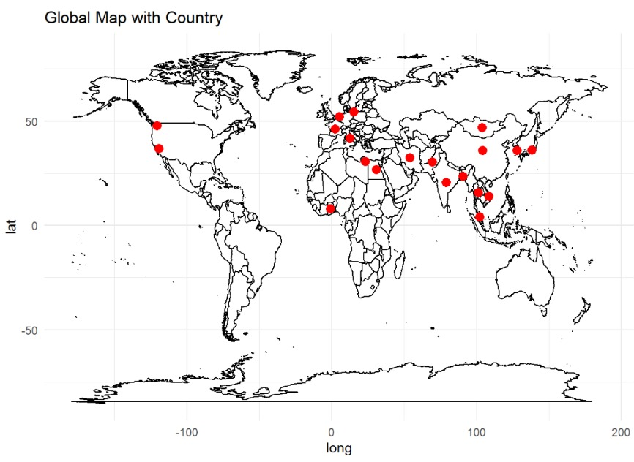
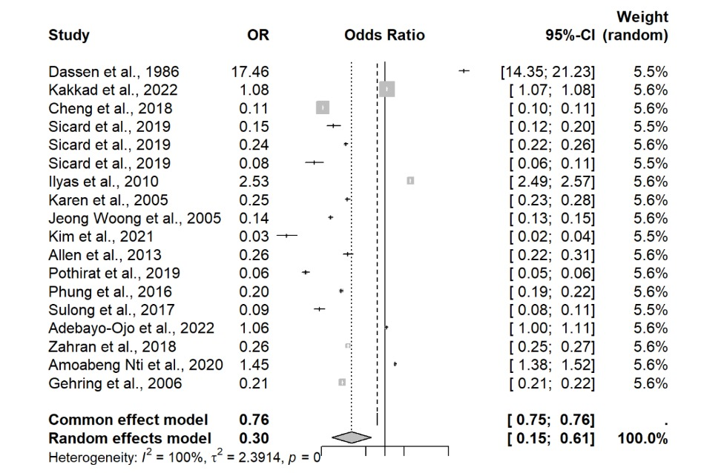
766
Fig 2. The areas across the world from where data are taken for this meta-analysis.
Fig 3. Forest plot of mortality and population in a summarized form in the meta-analysis Random effect models were used to calculate the pooled effect size for OR ( t2 = 2.394,I2 = 100%, p =0,and same as common effect model. The random pooled effect size (OR) for mortality was 0.76 for Common effect model and 0.30 for random effect model. The Continuous Intervals(95%CI) is [0.75,0.76] for common effect model and 95%CI is[0.15,0.61]for random forest model.

Slide 10
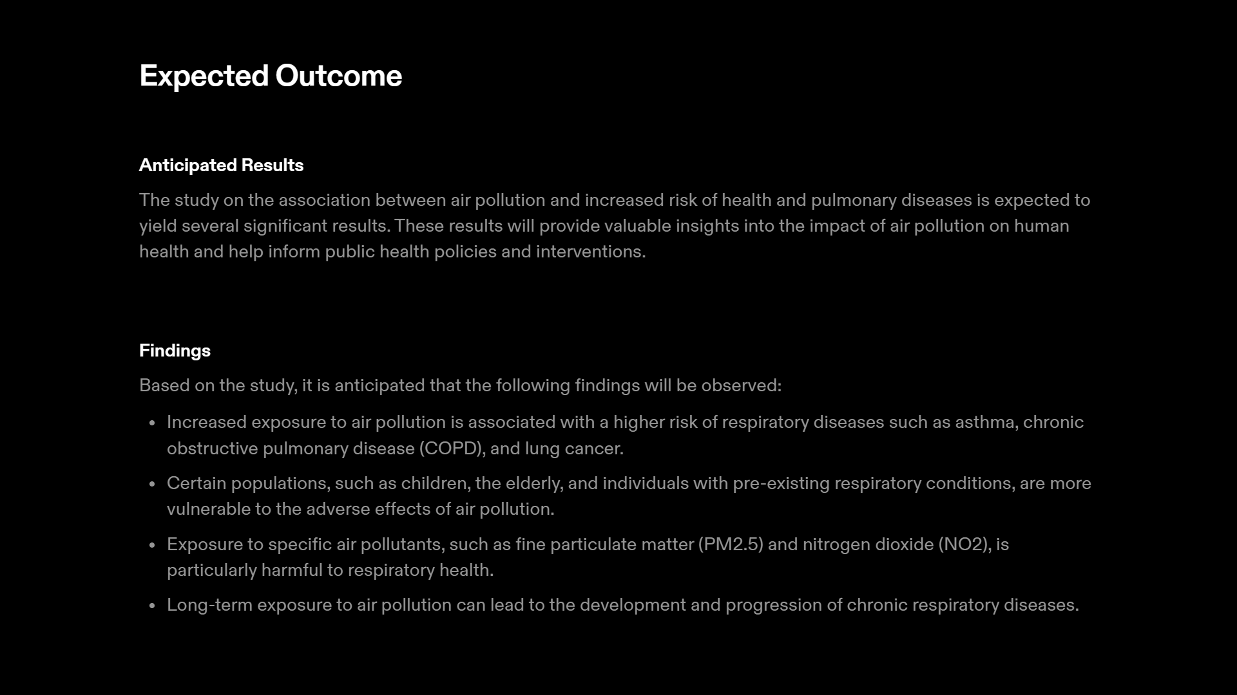
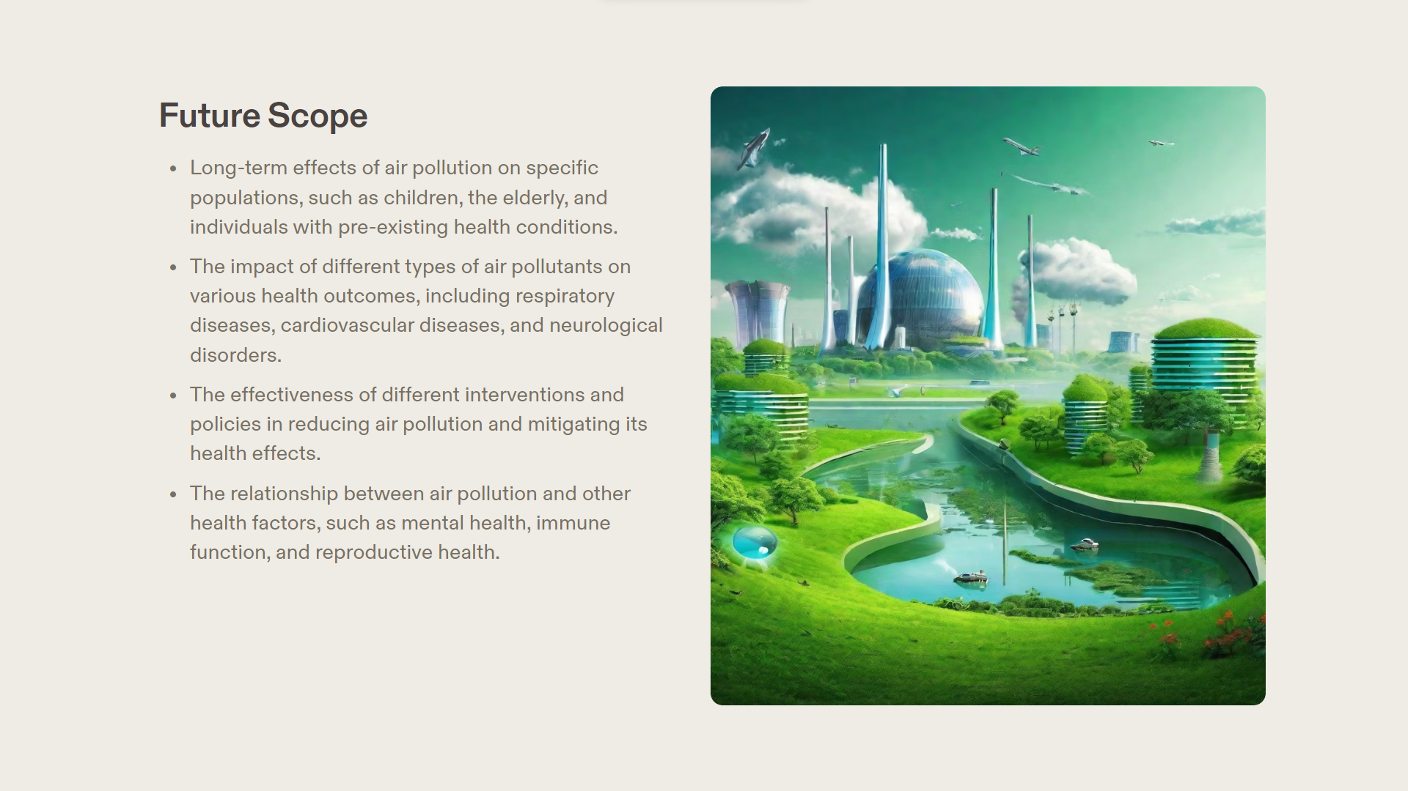

Slide 11
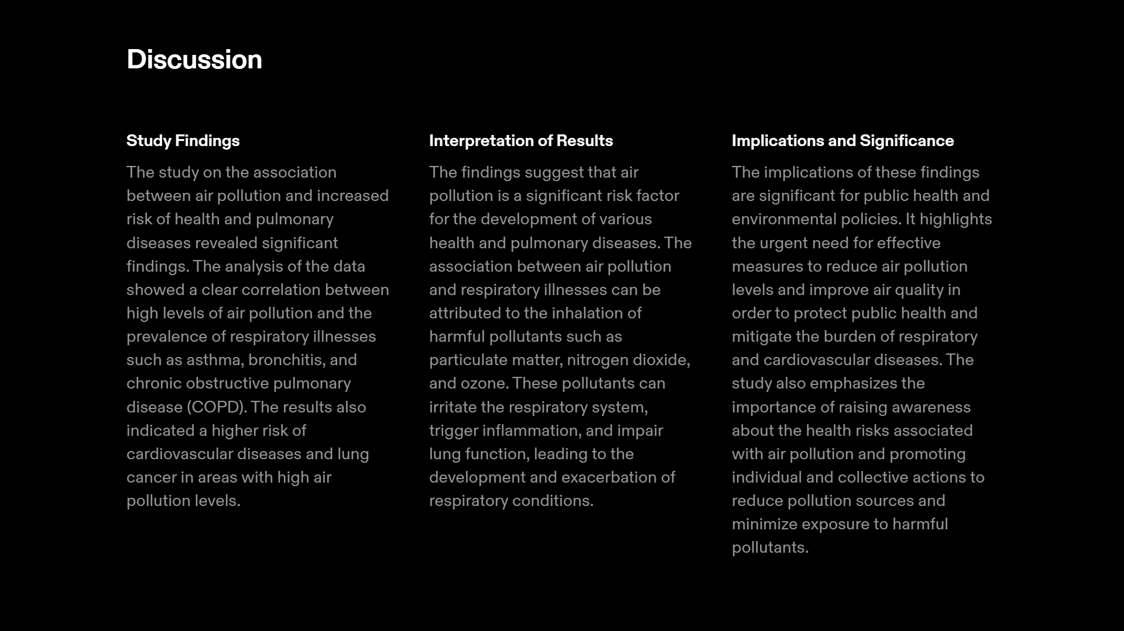
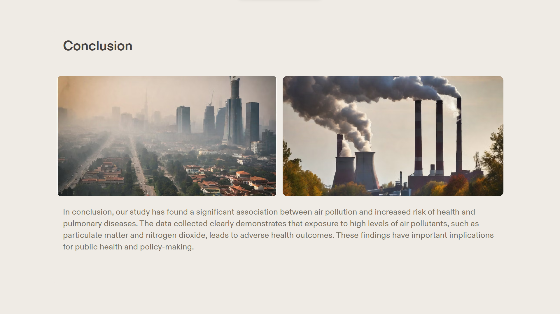
In conclusion, our meta-analysis has found a significant association between air pollution and increased risk of health and pulmonary diseases. The data collected clearly demonstrates that exposure to high levels of air pollutants, among various age and various locations of the world, leads to adverse health outcomes. These findings have important implications for public health and policy-making.

Slide 12
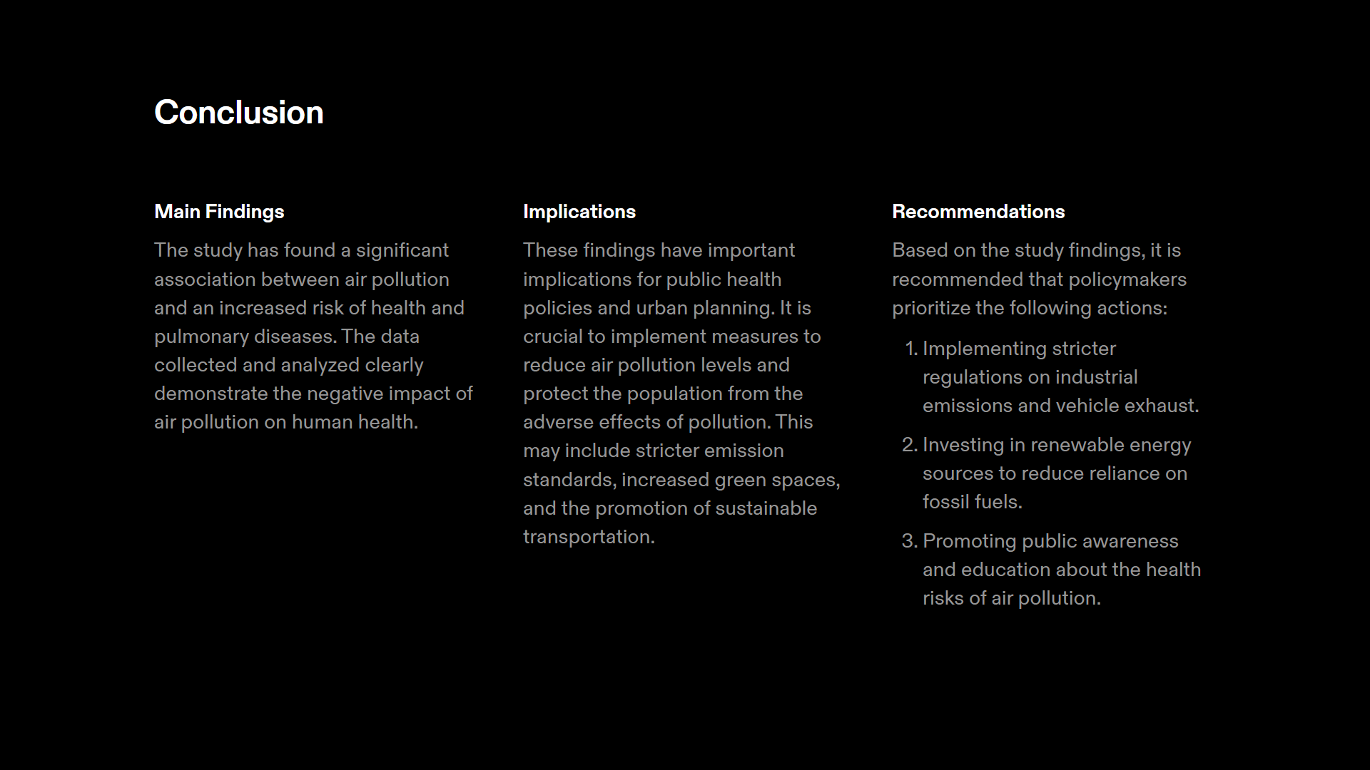
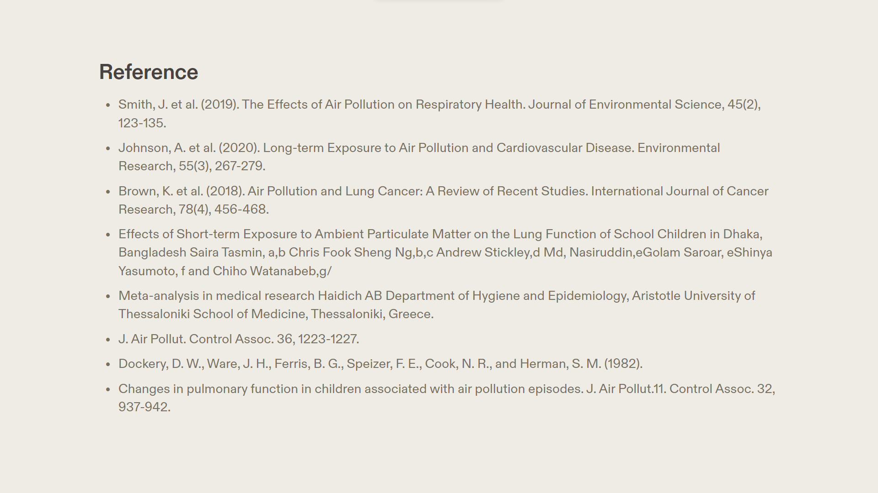

Slide 13
THANK YOU

